Slide 1

Seattle Airbnb Open Data Analysis and Prediction
Marwan Ali
Springboard Final Project Presentation

Slide 2
1
2
3
4
5
6
Contents
Business Overview
Dataset Explanation
Business Problem
A platform of accommodation
Listing, Reviews, and Calendar
“What you charge is always up to you”. Airbnb tag
EDA and Feature Engineering
Modeling and Summary
Conclusions and Suggestions Plan
Identify the high correlation coefficient features
To help customers better understand the root causes of the price to get better rates
Listing and adjust the identifiable features for better competition

Slide 3

1
Business Overview

Slide 4
Airbnb
is a platform of accommodation which match the needs of staying and of lending.
Last Minute Trip
Airbnb
Notes:
Their main source of income is the fee for host. Basically, as the number of transactions between the host and the guest increases, their profit also increases. So, it is important to their business and I expect it to be one of their KPIs.
- What can we do to increase the transactions? We considered three below questions to explore its way.
How long is the period available for lending by rooms? Is there rooms which is available all for years? or almost rooms are available on spot like one day or one week? Here, I want to know the trend in the outline of the data.
Is there a busy season? If the demand for accommodation is more than the number of rooms available for lending, it leads to the loss of business opportunities. So, I want to know whether is there the busy season. If this is true, we must create a mechanism to increase the number of rooms available for lending during the busy season.
Are there any trends of popular rooms? If this question's answer is true, we can suggest host to ways make the room easier to rent. In this part, I'll use machine learning technique.

Slide 5

2
Dataset Explanation

Slide 6
Listing Data
Reviews Data
Calendar Data
Airbnb Open Data
Including full descriptions and average review score
Including unique id for each reviewer and detailed comments
Including listing id and the price and availability for that day
Notes:
Overview
We used the Seattle Airbnb opensource data from kaggle, which includes the information of Airbnb listing with 3818 data points from a listings table, and about 1.4 million calendar activities associated with the listings from a calendar table.
Seasonality
The calendar table gives the activities of 3723 listing ids with the price and availability for individual days, where 99% of the activities are from the year 2016.
Price Features
The listings table includes full descriptions and average review scores. This table has 3818 data points and 91 features along with the price information. To better understand the correlation between the features and the price, it is important to reduce the dimensions of the features, and to understand which features are most important for the Airbnb price. Therefore, I built a price prediction model based on the features from the listings table and selected the top ranked features.

Slide 7

3
Business Problem

Slide 8

Problem
Solution
What are the most important ingredients/features for the Airbnb price?
Providing pricing tips for a new listing to assist hosts in accurately pricing their properties.
Notes:
The key stakeholders in Airbnb are the guests and the hosts. Airbnb goes by the tag – “What you charge is always up to you”. So, the hosts have freedom to set prices for their listings. Therefore, while listing a new property, hosts tend to compare similar properties and put a price close to similar listings. This may not be very accurate as the price depends on a lot of factors. So, the challenge for the host is to put an optimal price for the listing.
Airbnb generates revenue from the host by charging a service fee = 3% of (Nightly Rate + Cleaning Fee + Add. Guest fee) + VAT.
So, when a host is guided with pricing tips, the possibility of the host putting a very low or high price is less. This helps in the host increasing guests which in turn generates revenue for Airbnb.

Slide 9

EDA and Feature Engineering
4

Slide 10
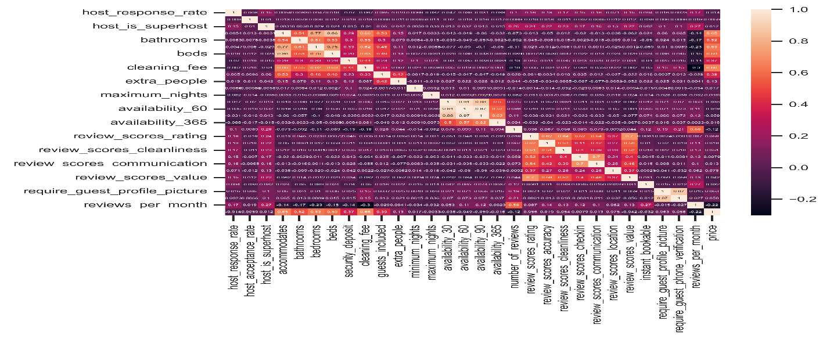
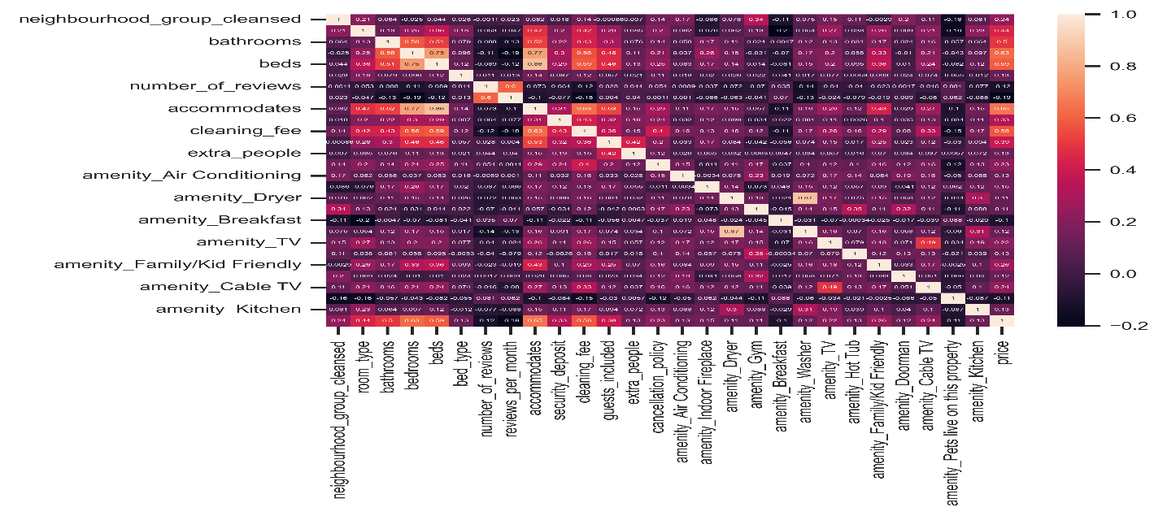
Heat Maps
Heat Map 1
Heat Map 2
Notes:
Pandas .corr() method calculates the Pearson correlation coefficient between every two features. And heatmap shows the relationship more clearly. Here, accommodates, bathrooms, bedrooms, beds, security_deposit, cleaning_fee, guests_included, extra_people have relatively higher correlation coefficient than other features with price.
Since Pandas .corr() only calculates the numeric data. I performed target encoding then drew the heatmap again. room_type, neighbourhood_group_cleansed, bed_type, cancellation_policy were categorical data that cannot be calculated the correlation coefficient. But after target encoding, they do have a very high impact on price. For the amenities, TV, Hot Tub, Kitchen, Indoor Fireplace, Dryer, Family/Kid Friendly, Doorman, Gym, Cable TV, Washer, Air Conditioning are the more critical than other amenities.

Slide 11
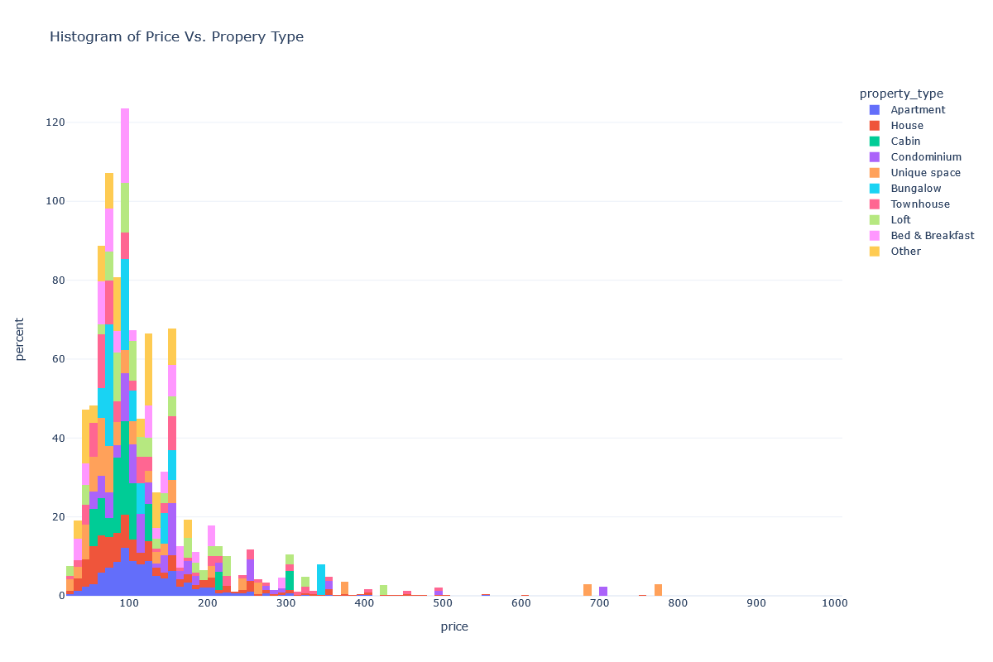
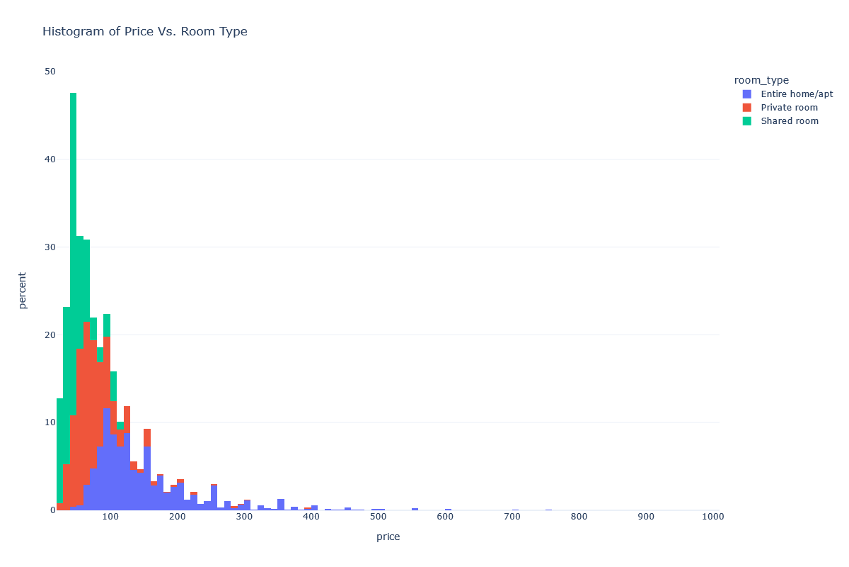
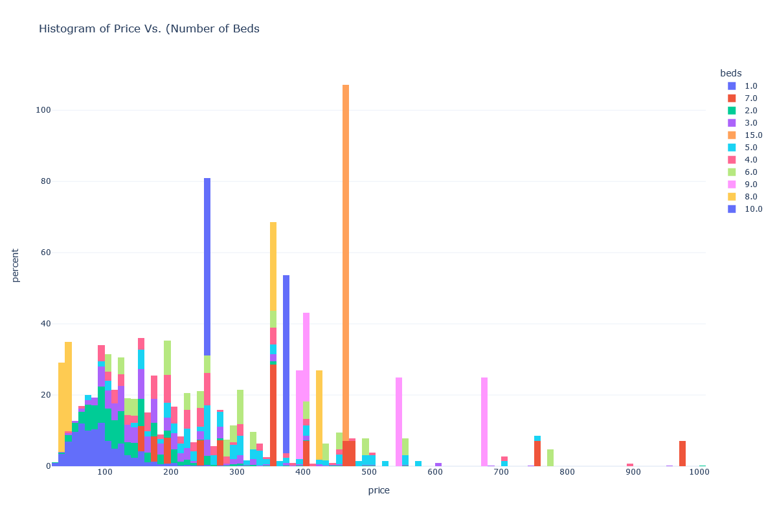
Histograms
Price Vs Property Type
Price Vs Room Type
Price Vs No. of Beds
Notes:
* we took a glance at the following high correlation coefficient features: accommodates, bathrooms, bedrooms, beds, security_deposit, cleaning_fee, guests_included, extra_people, room_type, neighbourhood_group_cleansed, bed_type, cancellation_policy

Slide 12
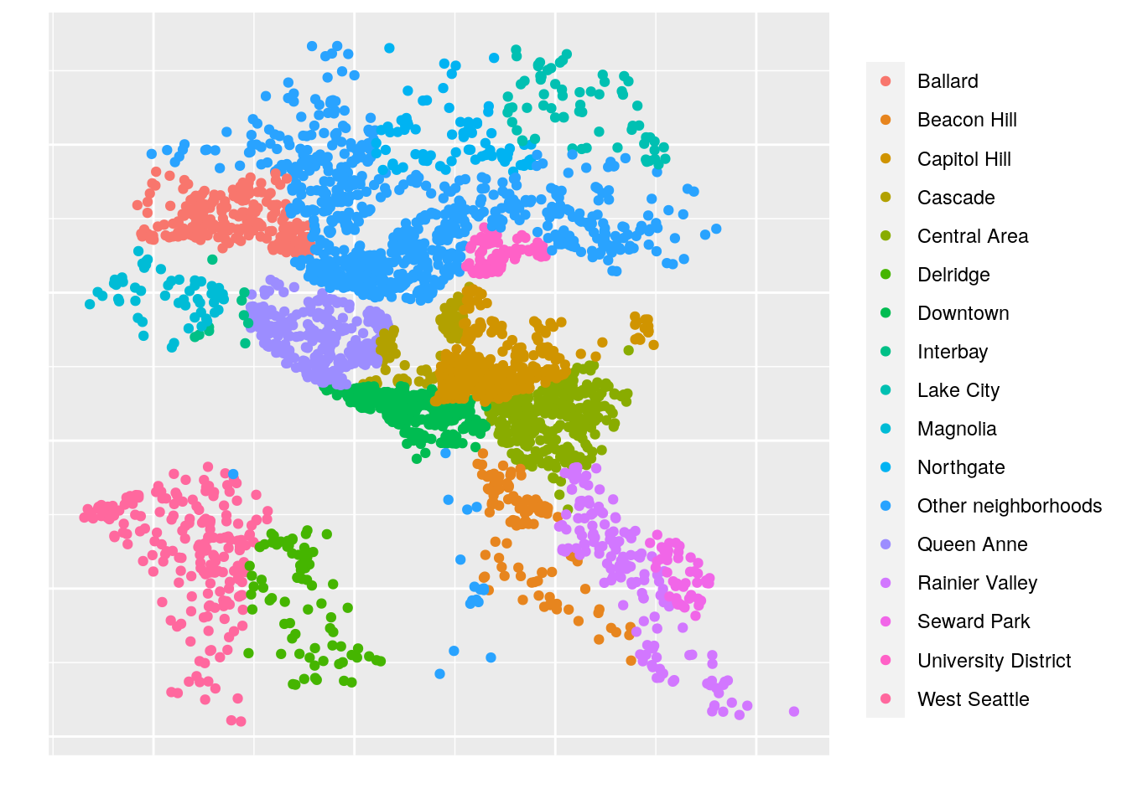
Market Size Essentials
63%
Occupancy- Entire Home
25%
45%
Capitol Hill
Type- House
Notes:
Listings
There are many different types of offerings on Airbnb depending on your budget. Full homes, Private rooms, and Shared rooms. The later of which is not very common in my experience. Also, homes can either be a house or an apartment, both fairly common in the Seattle area.
First thing, there is roughly a 2/3-1/3 split between entire homes and private rooms respectively. While shared rooms are offered in the city, they do have someone limited availability. Next, we see a rough 50/50 split between houses and apartments. Also note that I cut off several other times of different types of homes. The availibility of other property types, albeit with far fewer numbers, has been cut off. Also note that there are far more property types to show, but most are just far too rare to meaningfully graph alongside. For simplicity, if it comes up in the future, I will restrict the data to just houses and apartments.

Slide 13

05
Modeling and Summary

Slide 14


XGBoost
LightGBM
is an optimized distributed gradient boosting library designed to be highly efficient, flexible and portable
is a gradient boosting framework that uses tree based learning algorithms.
Notes:
The baseline can provide an insight into the performance of different data preprocessing strategies, such as encoding methods. Here, I chose target encoding. First, it had a better performance than ordinal encoding. Second, we already knew the categorical data have potential levels for a different price. e.g. different roomt_type has different price histogram.
Features marked as ML1 were defined by Airbnb for Machine Learning models. Then, as you can see, ML1 + ML2 is better than ML1, which means we found more features that were useful for Machine Learning.
Model Tuning
The Hyperparameter tuning platform I used to be Optuna. We implemented a logger to write the tuning results in the local log file. After all tunings are finished, the program will send an email to my mailbox with the best hyperparameters.
Model Blending
After hyperparameter tuning, we have a set of better hyperparameters for XGBoost and LightGBM. Then I performed a model blending for a better ML performance.
Model Stacking
Model Stacking is a way to improve model predictions by combining the outputs of multiple models and running them through another machine learning model called a meta-learner.
After hyperparameter tuning, we have a set of beter hyperparameters for XGBoost and LightGBM. Then I performed a model blending for a better ML performance.

Slide 15

Conclusions and Suggestions
06

Slide 16
Actionable Outcomes
Decrease the Following
Policy Change
Amenities
Extras
Good to Update
Hard to Change
Cleaning fees and Security deposits
Cancelations, Guest included, and Extra people
Cable TV, Air conditioning, family/ kid friendly
Doorman, gym, Dryer, and Indoor fire place
Room types and enteral decoration
Neighborhoods, bedrooms, and bathrooms
Notes:
Although we don't have the transaction data, and the number of reviews did not play an essential role in price prediction, I'm sure such features will influence the rank on the search engine.
Airbnb uses machine learning models to intensify the competition. They can provide Price Tips, Smart Pricing, and improvement suggestions to the host. As a host, you can combine the models and good strategies to maximize your competitiveness and profit. Airbnb users are also benefited from the perfect competition.

Slide 17
References
Data.gov. (2021). Data Catalog, Traffic Crashes. [Data set]. https://www.kaggle.com/datasets/airbnb/seattle
Hotel Business Plan [PowerPoint slides]. (n.d.). Slidesgo. https://slidesgo.com/theme/hotel-business-plan
Springboard Data Science Career Track Syllabus.

